Slide 1


Bluetooth Communication
Associate Professor
Department of Computer Science and Engineering

Slide 2

Session Objectives
After completion of the session you will be able to understand
Blutooth communication
Piconet and Scatternet
Bluetooth Communication Architecture

Slide 3
Introduction
Bluetooth is a wireless technology standard used for exchanging data between fixed and mobile devices such as telephones, notebooks, computers, cameras, printers etc. over short distances using short-wavelength UHF radio waves.
It operates in the frequency band from 2.402 GHz to 2.480 GHz, and building personal area networks (PANs).
A Bluetooth LAN is an ad hoc network and can be created spontaneously.
Used to connect devices of different functions when they are at a short distance from each other.
Bluetooth uses IEEE 802.15 standard.
Bluetooth is managed by the Bluetooth Special Interest Group (SIG), which has more than 35,000 member companies in the areas of telecommunication, computing, networking, and consumer electronics.

Slide 4
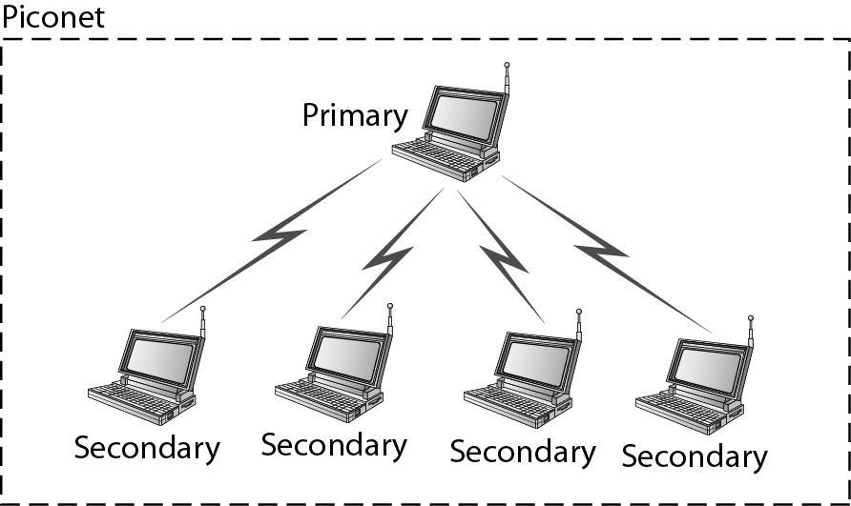
Communication and Connection
Piconet
An ad-hoc network of devices in communication range.
Allow interconnection of a maximum of seven devices together.
The devices are segregated among master/primary and slaves.
A master/primary is usually a requester for a service and initiates a connection.

Slide 5
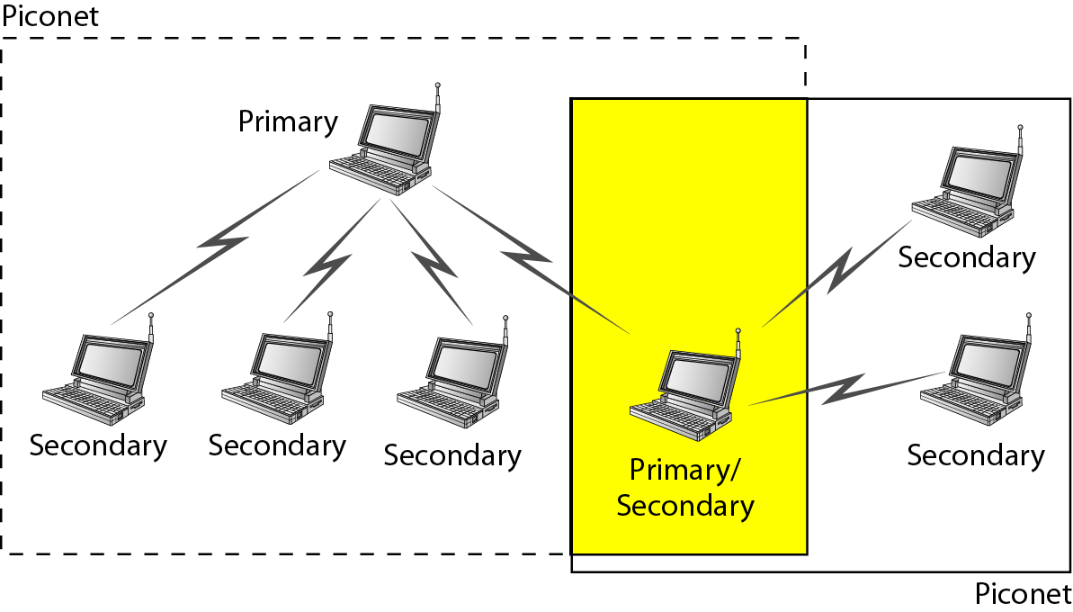
Communication and Connection
Scatternet
The connection of two or more piconets.
In Scatternet certain devices simultaneously play the master role in one piconet and the slave role in another.
The master chooses which slave device to address; typically, it switches rapidly from one device to another in a round-robin fashion.

Slide 6
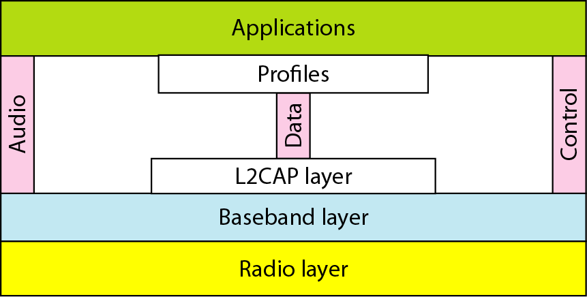
Communication Architecture

Slide 7
Contd….
Bluetooth Radio
The lowest defined layer of the Bluetooth specification
Operating in the 2.4 GHz ISM Band
Uses frequency hopping (FHSS) from 2.402 GHz to 2.480 GHz
Baseband Layer
It is the physical layer of the Bluetooth that provides Error correction, Flow control, Hopping sequence, Security.
Hopping through 79 channels.
Data is divided in packets having
    access code: e.g. timing synchronization
    header: e.g. packet numbering, flow control, slave address
    payload: voice, data or both

Slide 8
Contd….
Audio Layer
Two coding methods: PCM and CVSD, both at 64kbit/s
Synchronous connection oriented (SCO) links
Time-critical: intended for audio stream transfer in real time
No retransmission
Errors appear as background noise
Control Layer
Provides a command interface to baseband controller and link manager
Controls hardware status and event register
Bluetooth defined Host Controller Transport Layers are: UART (HCI over serial interface), RS232(HCI over serial interface), USB(HCI over USB interface e.g. USB dongle)

Slide 9
Contd….
L2CAP (Logical Link Control and Adaptation Protocol)
Provides a connection-oriented and connectionless service to upper layer
Protocols with quality-of-service functions using multiplexing, segmentation and reassembly
Two link types defined in Baseband layer:
SCO (synchronous connection-oriented): is Point to Point Connection between only one master and only one slave.
ACL (asynchronous connection-less): is multipoint connection between one master and many slaves.

Slide 10
Summary
In this session we have learned
Bluetooth communication
Architecture of Bluetooth Communication
The components of Bluetooth Communication

Slide 11

Notes:
1.#

